Slide 1
Ordinal utility
Ordinal utility holds that utility cannot be measured but can be ordered according to consumers’ preferences.
Different product combinations may be viewed as having same utility,
And these combinations of same utility consist of one Indifference Curve (IC).

Slide 2
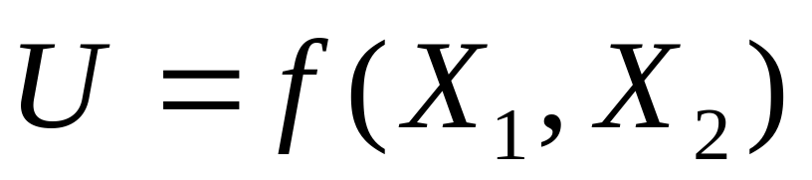
Indifference Curve
Indifference Curve (IC) contains points representing market baskets among which the consumer is indifferent.

Slide 3
indifference curve
A locus of points representing different bundles of goods and services, each of which yields the same level of total utility.

Slide 4
Indifference curve（IC）
Increasing satisfaction
X₂
I₃
I₂
I₁
O
X₁

Slide 5
The important things of IC
IC is convex to the origin.
Every indifference curve must (?) slope downward and to the right;
Indifference curves cannot intersect.

Slide 6
Another important but not mentioned thing about IC:
A consumer has many indifference curves;
How do you understand this attribute?

Slide 7
X₂
U = f（X₁，X₂）= U₁
A
IC
ΔX₂
ΔX₂ /ΔX₁
B
C
ΔX₁=1
ΔX₁=1
O
X₁

Slide 8
Marginal Rate of Substitution (MRS)
MRS is defined as the number of units of good Y that must be given up if consumer is to receive an extra unit of good X and to maintain a constant level of satisfaction.

Slide 9
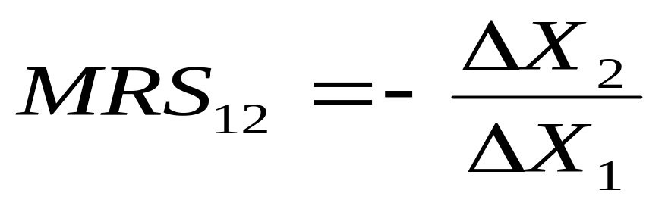
To calculate MRS

Slide 10
Not all indifference curves must slope downward.
Can you name some other cases?
What will the IC of substitutes & complements?

Slide 11
IC of substitutes
X₂
I₂
I₁
O
X₁

Slide 12
IC of compliments
X₂
I₂
I₁
X₁

Slide 13
The budget line
Consumers want to be most satisfactory, but to be constrained by their income (budget).
Budget refers to various possible combinations of products that consumers can buy when their income & products’ prices are set.

Slide 14
The budget line
X₂
I / P₂
Budget Space
I / P₁
X₁

Slide 15
Variation of budget line
Discuss
P₁& P₂ hold constant while I changes;
I holds constant while P1&P2 change proportionately;
I holds constant while P1 or P2 changes;
I, P1&P2 increase or decrease proportionately at the same time.

Slide 16
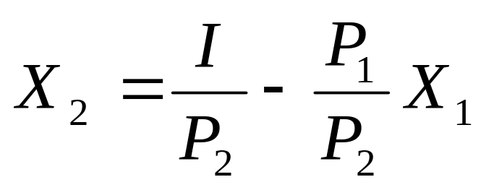
“I” changes
X₂
I / P₂
I decrease I increase
X₁
I / P₁

Slide 17
P₁ changes
X₂
I / P₂
P₁ increases P₁ decreases
I / P₁
X₁

Slide 18
Question
What if P₂ changes ?
And I, P₁ & P₂ change?

Slide 19
The Equilibrium of Market Basket
Consumers want to be most satisfactory;
But they are constrained by their income (budget).
Consumers (rational) want to maximize their utility with limited income.

Slide 20
Budget line & Indifference curve
X₂
Discuss:
How do you understand E?
B
E
I₂
I₁
C
I₃
O
X₁

Slide 21
If only prices change
Price changes → PCC
Y
PCC
E₃
Price-Consumption curve
E₁
E₂
I₃
I₂
I₁
O
X_{E1}
X_{E2}
X_{E3}
X

Slide 22
If only income changes
Y
Income changes
→ ICC
ICC
A₃
A₂
E₃
E₂
A₁
I₃
E₁
I₁
I₂
O
X_{E1}
X_{E2}
X_{E3}
X

Slide 23
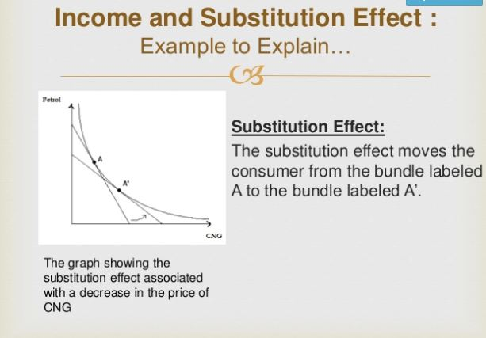

Slide 24
